Slide 1


SEPOL 416 Capstone Project: Decoding Market Reactions: Unveiling the Impact of FOMC Statements with NLP and Machine Learning Methods
Qingyang Tian
Notes:
Good afternoon, everyone. I am Qingyang, and I’ll introduce my capstone project ‘The Influence of FOMC Communications on Financial Markets

Slide 2
Outline
I. Introduction & Target Audience
II. Prior Research
III. Data Preparation & EDA
IV. Model
V. Results
VI. Policy Insights
VII. Next Steps
Notes:
And you can see the six sections of our presentation on the screen . Let’s get started.

Slide 3
Workflow
Data Collection
Data Processing
NLP Analysis
Exploratory Data Analysis
Machine
Learning
Model
Evaluation
Collect 2004 to 2024 FOMC statements from the Federal Reserve Board
Data Import & Cleaning
Extract Specific Keywords and Compute TF-IDF
S&P 500 Index volatility over time
Time series Train-Test Split
(80,20), predict the differences for the last 20% of the dataset
Cross Validation & hyperparameter Tuning
Select specific FOMC meeting date from Federal Reserve Board
Extract Sentiments Using FinBERT
Distribution of market difference after 1 day, 1 week & 4 week
Collect Stock Price Indexes
from
Different industries of S&P 500
Model training with Logistic regression, Random Forest
Confusion Matrix & Accuracy, Recall, Precision, F1 Scores
Calculate the Difference of index closing prices within a day, a week, and 4 weeks
Extract BERT-Based Features Using FinBERT and PCA analysis
Correlation between FinBERT Sentiment & Market Difference
Notes:
This is my workflow. After collecting and processing data, I graded tweets sentiments, and cluster them by region and days, also create new weighted scores.
After creating financial indicators, i merged sentiments and financial data to show the pattern.
Lastly, I split the data into training and test sets, and train model using ML methods.
Doing cross validation and hyper parameter tuning to find the best model and predict the trend.

Slide 4
I. Background
Introduction to FOMC
The Federal Open Market Committee (FOMC) plays a crucial role in setting U.S. monetary policy.
Frequency：8 times per year
Market participants closely analyze FOMC statements, which influence investor expectations and risk sentiment.
These communications impact asset prices in various financial markets, including:
Equities (Stock Market) 📈📉
Bonds & Interest Rates 📊
Foreign Exchange (FX) 💱
Commodities (Gold, Oil, etc.) 🛢️
Notes:
The Federal Open Market Committee (FOMC) is a key body within the Federal Reserve responsible for setting U.S. monetary policy. It makes critical decisions about interest rates, money supply, and economic stability, which directly impact financial markets. The FOMC meets eight times per year, or about every six weeks. Each meeting is closely watched by investors, economists, and policymakers because its decisions influence interest rates and market expectations. Market participants carefully analyze FOMC statements, press conferences, and meeting minutes. Why? Because these communications affect investor sentiment, risk appetite, and financial markets. Even subtle changes in wording can move markets significantly
The FOMC’s decisions influence asset prices across multiple financial markets

Slide 5
II. Research Questions
Research Purpose
To examine the correlation between Federal Open Market Committee (FOMC) statements and financial markets, particularly stock price movements.
Motivation for This Research
Financial Market Sensitivity
Bridging Economic Policy & Market Behavior
Advancements in NLP Tools
Central Bank Communication is Critical
Research Question：
How do FOMC meeting statements impact investor sentiment, stock market volatility, and asset price trends?
Notes:
Motivation for This Research
Central Bank Communication is Critical: Market participants rely on FOMC statements to gauge future monetary policy decisions, making it essential to understand its impact.
Financial Market Sensitivity: Even subtle changes in FOMC language can influence investor expectations, interest rates, and market reactions.
Bridging Economic Policy & Market Behavior: Analyzing the sentiment and structure of FOMC communications helps in understanding how policy signals translate into financial decisions.
Advancements in NLP Tools: With machine learning and NLP techniques, we can now quantify and analyze policy-driven market movements more effectively.

Slide 6
II. Background
Prior Research
Use NLP tools to provide measure of how changes in qualitative descriptions of the economy in post-meeting statements affect bond prices (Taeyoung et al., 2021)
Explores fine-tuning FinBERT to analyze sentiment in FOMC minutes, and the model is trained on FOMC texts to capture nuanced sentiment, enhancing its ability to interpret monetary policy communications. (Ziwei et al, 2023)
Applied Loughran-McDonald sentiment analysis, BERT, and XLNet to analyze FOMC statements, predicting federal funds rate changes and their correlation with S&P 500 performance.(Tomokuni et al. 2023)
Gap：
Using various NLP tools to analyze the impact brought by the FOMC minutes to the Specific industries of the Stock Market

Slide 7
II. Background
My research: Stock Market Indexes from different industries
Symbol | Index Name | Description
^SP500-60 | S&P 500 Real Estate (Sector) | Tracks the real estate sector within the S&P 500, including REITs and property investment firms.
^SP500-50 | S&P 500 Utilities (Sector) | Focuses on utility companies (electricity, water, gas) within the S&P 500.
^SP500-25 | S&P 500 Consumer Discretionary (Sector) | Represents consumer discretionary stocks (e.g., retail, entertainment, automotive) within the S&P 500.

Slide 8
III. Data and identification strategy
Data Sources
FOMC Meeting Statements (2004-2024) from the Federal Reserve Board
Stock Market Data For Different Industries (Real Estate, Utilities, Consumer Discretionary) from Yahoo Finance
NLP Tools Used
Text Analysis (TF-IDF): Identifying Hawkish and Dovish Keywords from the FOMC Statements and then apply TF-IDF vectorization.
Sentiment Analysis (FinBert): Measuring sentiment in FOMC Statements and divided into three groups (Hawkish, Neutral, Dovish Score)
Correlation Analysis: Examining market responses to FOMC statements over time.
Control Group: Financial Data before the release date of the FOMC Statements
Target Group: Financial Data before the release date of the FOMC Statements (one day after, a week after, 4 weeks after, 6 weeks after)

Slide 9
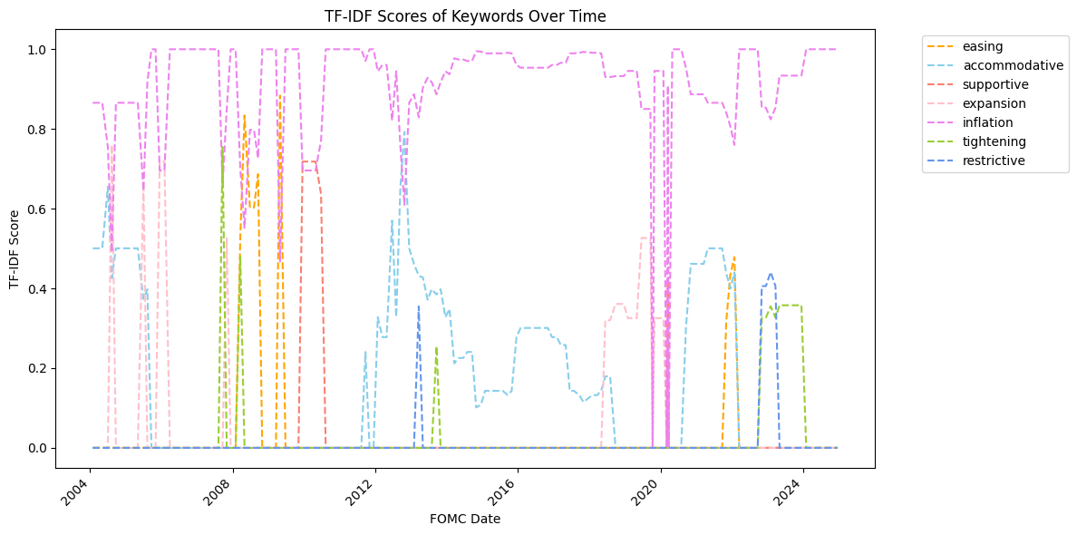
IV. NLP Analysis ---- TF-IDF
Keywords Selection:
Dovish_Keywords = ["easing", "accommodative", "supportive", "expansion”]
Hawkish_Keywords = ["inflation", "tightening"]
"Inflation" consistently has high relevance, peaking in recent years, but experienced a sudden drop in 2020 year.
"Easing" & "Accommodative" were prominent before 2008 & 2020, likely during economic stimulus periods.
"Tightening" & "Restrictive" gained relevance post-2008 and again post-2020, indicating policy shifts toward tightening.
"Expansion" & "Supportive" had temporary spikes, aligning with economic stimulus phases.
Notes:
"Inflation" (pink) consistently has high relevance, peaking in recent years.
"Easing" & "Accommodative" were prominent before 2008 & 2020, likely during economic stimulus periods.
"Tightening" & "Restrictive" gained relevance post-2008 and again post-2020, indicating policy shifts toward tightening.
"Expansion" & "Supportive" had temporary spikes, aligning with economic stimulus phases.

Slide 10
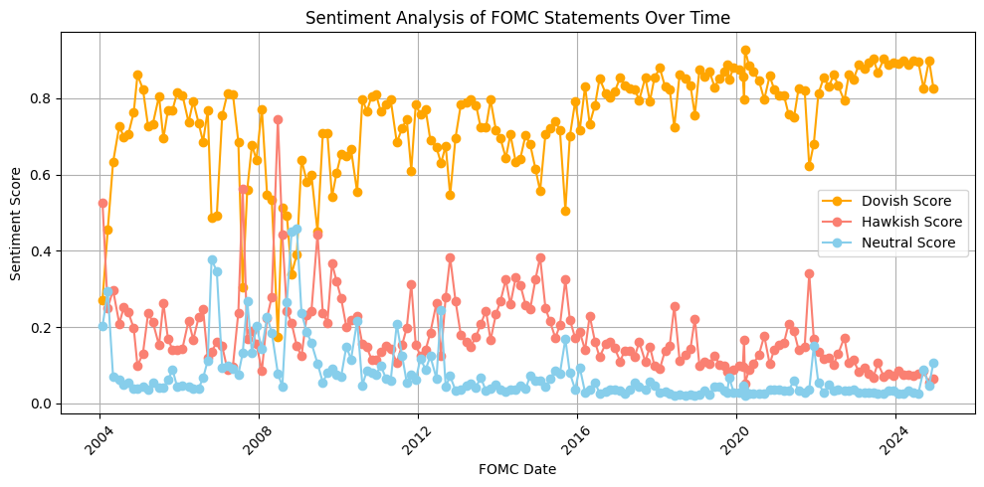
IV. NLP Analysis ---- Sentiment Analysis
Dovish sentiment (orange, high values)
Hawkish sentiment (red, fluctuating)
Neutral sentiment (blue, consistently low)
dominates, suggesting a preference for lower interest rates and economic support.
spikes during 2008-2010 and 2016-2018, aligning with tightening cycles and rate hikes.
remains minor, indicating statements generally lean toward a stance rather than neutrality.
2008 Crisis
Dovish sentiment drops sharply, while Hawkish sentiment rises, reflecting crisis-driven uncertainty.
2016 - 2018
Hawkish sentiment spikes, indicating interest rate hikes
Post 2020
Dovish sentiment rebounds, suggesting accommodative policies post-pandemic.
Notes:
Polarity (Sentiment Score):
Measures how positive, negative, or neutral a piece of text is.
Ranging from -1 (negative) to +1 (positive)
Subjectivity (Opinion vs. Fact):
Measures how opinionated or factual a text is.
Ranging from 0 (objective, factual) to 1 (highly subjective, opinion-based).
Polarity (Blue Line - Left Y-Axis)
Measures sentiment tone (higher = more positive).
Fluctuates over time, indicating shifts in FOMC messaging.
Dips may align with economic concerns (e.g., inflation, recessions).
Subjectivity (Orange Line - Right Y-Axis)
Measures fact vs. opinion (higher = more interpretative language).
Slight upward trend suggests FOMC statements are becoming more opinionated over time.
Spikes may signal uncertainty or major policy changes.
Polarity & Subjectivity Relationship
Both increasing → Optimistic & opinionated guidance.
FOMC minutes have a neutral to slightly positive tone (polarity between 0.05 and 0.11).Most frequent sentiment value is around 0.09, indicating a consistent communication strategy.No negative sentiment suggests the FOMC avoids alarming language to maintain market stability. Right-skewed distribution implies FOMC statements are cautiously optimistic rather than extreme.

Slide 11
IV. NLP Analysis ---- Extract BERT-Based Features Using FinBERT and PCA analysis
FinBERT Embeddings (768 Dimensions)
FinBERT is a finance-specific BERT model used for NLP in financial texts.
It converts text into 768-dimensional embeddings for numerical analysis.
Dimensionality Reduction Using Principal Component Analysis
PCA reduces feature dimensions while keeping 90% variance.
Helps in improving computation efficiency and avoiding overfitting.
Results: Original shape: (171, 768), Reduced Shape: (171, 30)
Reduced 768 variables to 30
Input Variables
Keywords TF-IDF values
Sentiment Scores
Output Variables
S&P 500 Difference (+1)
S&P 500 Difference(+5)
BERT-based Features by using PCA Analysis
S&P 500 Difference(+20)
Notes:
Polarity (Sentiment Score):
Measures how positive, negative, or neutral a piece of text is.
Ranging from -1 (negative) to +1 (positive)
Subjectivity (Opinion vs. Fact):
Measures how opinionated or factual a text is.
Ranging from 0 (objective, factual) to 1 (highly subjective, opinion-based).
Polarity (Blue Line - Left Y-Axis)
Measures sentiment tone (higher = more positive).
Fluctuates over time, indicating shifts in FOMC messaging.
Dips may align with economic concerns (e.g., inflation, recessions).
Subjectivity (Orange Line - Right Y-Axis)
Measures fact vs. opinion (higher = more interpretative language).
Slight upward trend suggests FOMC statements are becoming more opinionated over time.
Spikes may signal uncertainty or major policy changes.
Polarity & Subjectivity Relationship
Both increasing → Optimistic & opinionated guidance.
FOMC minutes have a neutral to slightly positive tone (polarity between 0.05 and 0.11).Most frequent sentiment value is around 0.09, indicating a consistent communication strategy.No negative sentiment suggests the FOMC avoids alarming language to maintain market stability. Right-skewed distribution implies FOMC statements are cautiously optimistic rather than extreme.

Slide 12
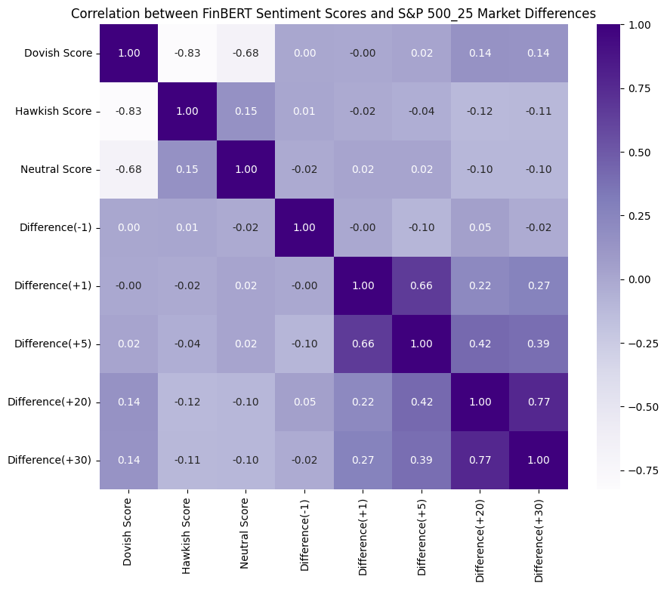
V. EDA
Notes:
As we move forward, we have three key steps to deepen our understanding of FOMC sentiment and its impact on financial markets.
First, we’ll apply Topic Modeling using LDA to uncover the dominant themes in FOMC communications, such as inflation, employment, and rate hikes. This will help us analyze how these topics shift alongside sentiment changes over time.
Next, we’ll compare sentiment data with S&P 500 movements, overlaying FOMC tone shifts with market rallies and dips. This will allow us to assess whether investor reactions align with policy tone changes.
Finally, we’ll conduct a Regression Analysis to statistically quantify the impact of FOMC sentiment on stock market volatility. By doing this, we can measure the extent to which central bank communications drive market fluctuations.
These steps will provide data-driven insights into how monetary policy messaging influences financial markets, helping both policymakers and investors make better-informed decisions."

Slide 13
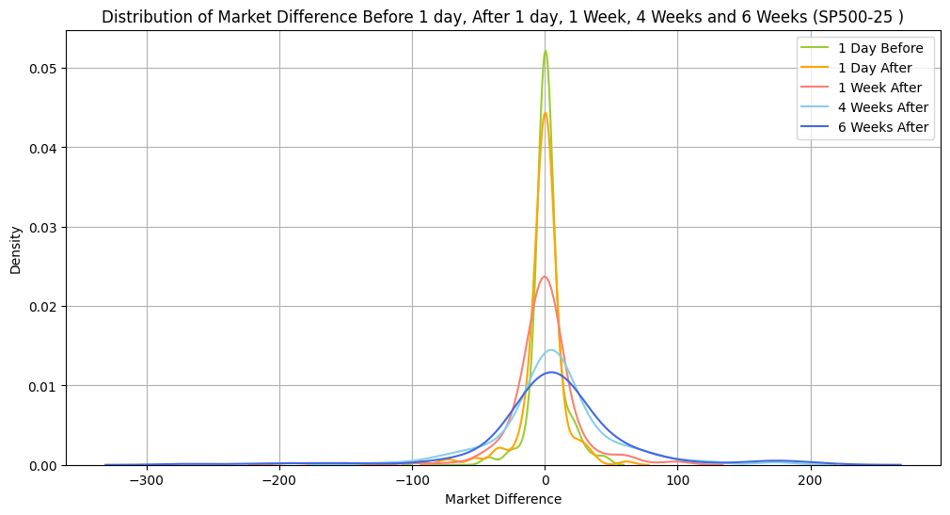
V. EDA
Notes:
As we move forward, we have three key steps to deepen our understanding of FOMC sentiment and its impact on financial markets.
First, we’ll apply Topic Modeling using LDA to uncover the dominant themes in FOMC communications, such as inflation, employment, and rate hikes. This will help us analyze how these topics shift alongside sentiment changes over time.
Next, we’ll compare sentiment data with S&P 500 movements, overlaying FOMC tone shifts with market rallies and dips. This will allow us to assess whether investor reactions align with policy tone changes.
Finally, we’ll conduct a Regression Analysis to statistically quantify the impact of FOMC sentiment on stock market volatility. By doing this, we can measure the extent to which central bank communications drive market fluctuations.
These steps will provide data-driven insights into how monetary policy messaging influences financial markets, helping both policymakers and investors make better-informed decisions."

Slide 14
VI. Models Evaluation

Slide 15
VI. Policy Insights and Next Steps
Notes:
As we move forward, we have three key steps to deepen our understanding of FOMC sentiment and its impact on financial markets.
First, we’ll apply Topic Modeling using LDA to uncover the dominant themes in FOMC communications, such as inflation, employment, and rate hikes. This will help us analyze how these topics shift alongside sentiment changes over time.
Next, we’ll compare sentiment data with S&P 500 movements, overlaying FOMC tone shifts with market rallies and dips. This will allow us to assess whether investor reactions align with policy tone changes.
Finally, we’ll conduct a Regression Analysis to statistically quantify the impact of FOMC sentiment on stock market volatility. By doing this, we can measure the extent to which central bank communications drive market fluctuations.
These steps will provide data-driven insights into how monetary policy messaging influences financial markets, helping both policymakers and investors make better-informed decisions."

Slide 16
Reference
Doh, T., Kim, S., & Yang, S.-K. X. (2021, February 11). How You Say It Matters: Text Analysis of FOMC Statements Using Natural Language Processing. Kansascityfed.org. https://www.kansascityfed.org/research/economic-review/how-you-say-it-matters-text-analysis-of-fomc-statements-using-natural-language-processing/
Gössi, S., Chen, Z., Kim, W., Bermeitinger, B., & Handschuh, S. (2023). Finbert-FOMC: Fine-tuned FinBERT model with sentiment focus method for enhancing sentiment analysis of FOMC minutes. 4th ACM International Conference on AI in Finance, 357–364. https://doi.org/10.1145/3604237.3626843
Higano, Tomokuni, et al. “Machine Learning and FOMC Statements: What’s the Sentiment?” CFA Institute Enterprising Investor, 18 Jan. 2023, blogs.cfainstitute.org/investor/2023/01/18/machine-learning-and-fomc- statements-whats-the-sentiment/.

Slide 17
Q & A

Slide 18
Thanks for watching~

